Slide 1
Controlling IOT Devices with the Pow!r Mount Plus app
Guide to accessing Wink devices through
the Pow!r Mount Plus app
Follow the step by step instructions to add access to your Wink account in the Power Mount app. After this you will be able to control devices through the Power Mount app.
This tutorial assumes you have a Wink account and Wink hub setup, along with devices like lights and locks paired to the hub

Slide 2
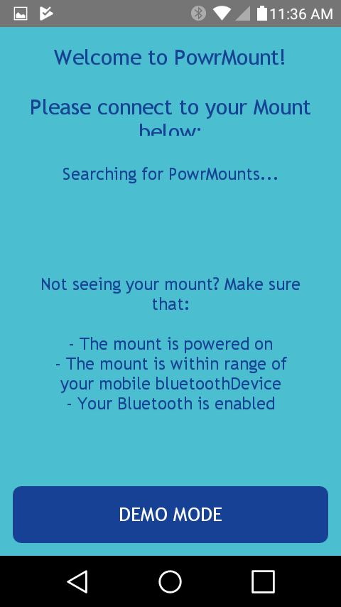
Open Pow!r Mount app
Open the Power Mount app.
Connect to your Power Mount, or select Demo Mode.

Slide 3
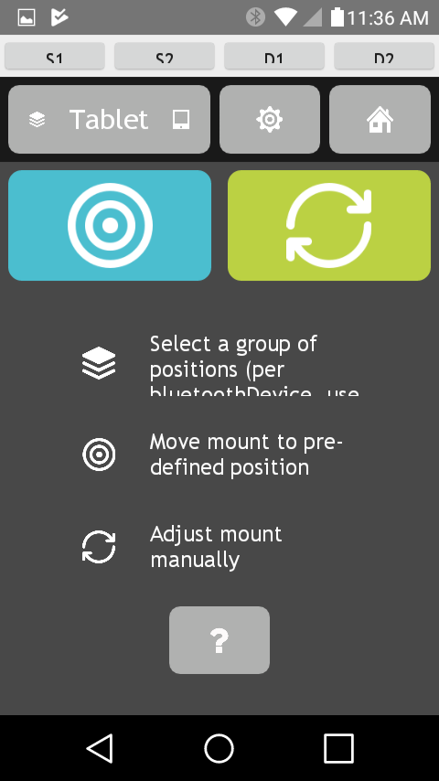
Select settings
Go to the home screen
Select the gear icon to access settings

Slide 4
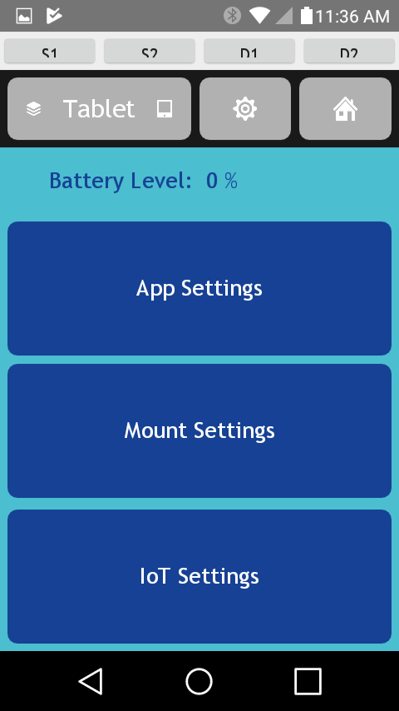
Select IOT Settings
In the Settings menu, select IoT Settings.

Slide 5
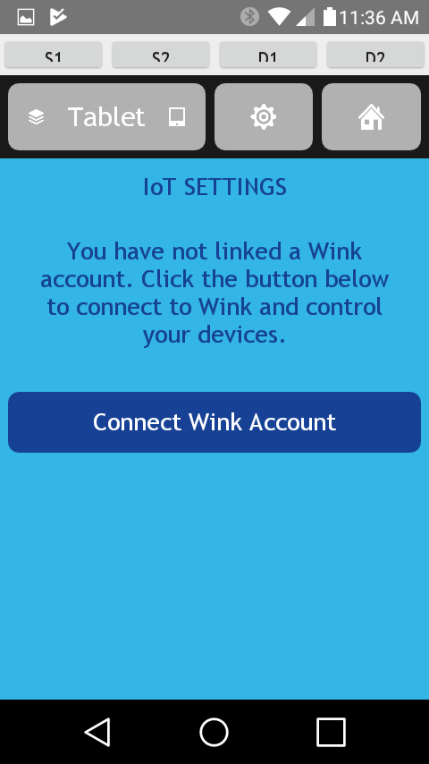
Select Connect Wink Account
Select Connect Wink Account to open a login screen for Wink.

Slide 6
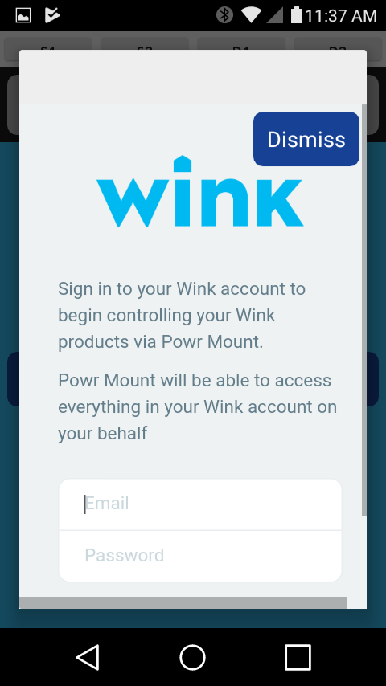
Sign in to Wink
Enter the email and password you used to create your Wink account.
Note that this must be the primary Wink account to see all devices.
Accounts that have shared access will not see all devices

Slide 7
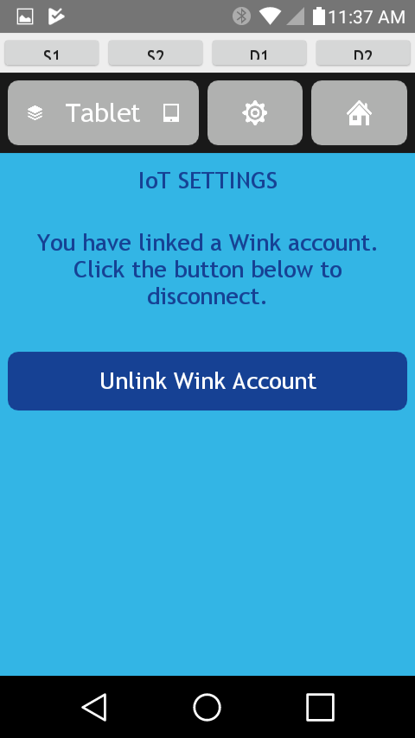
IoT Settings with Wink Linked
The app will return to the IoT settings screen showing that you have a linked Wink account.
Select the Home icon

Slide 8
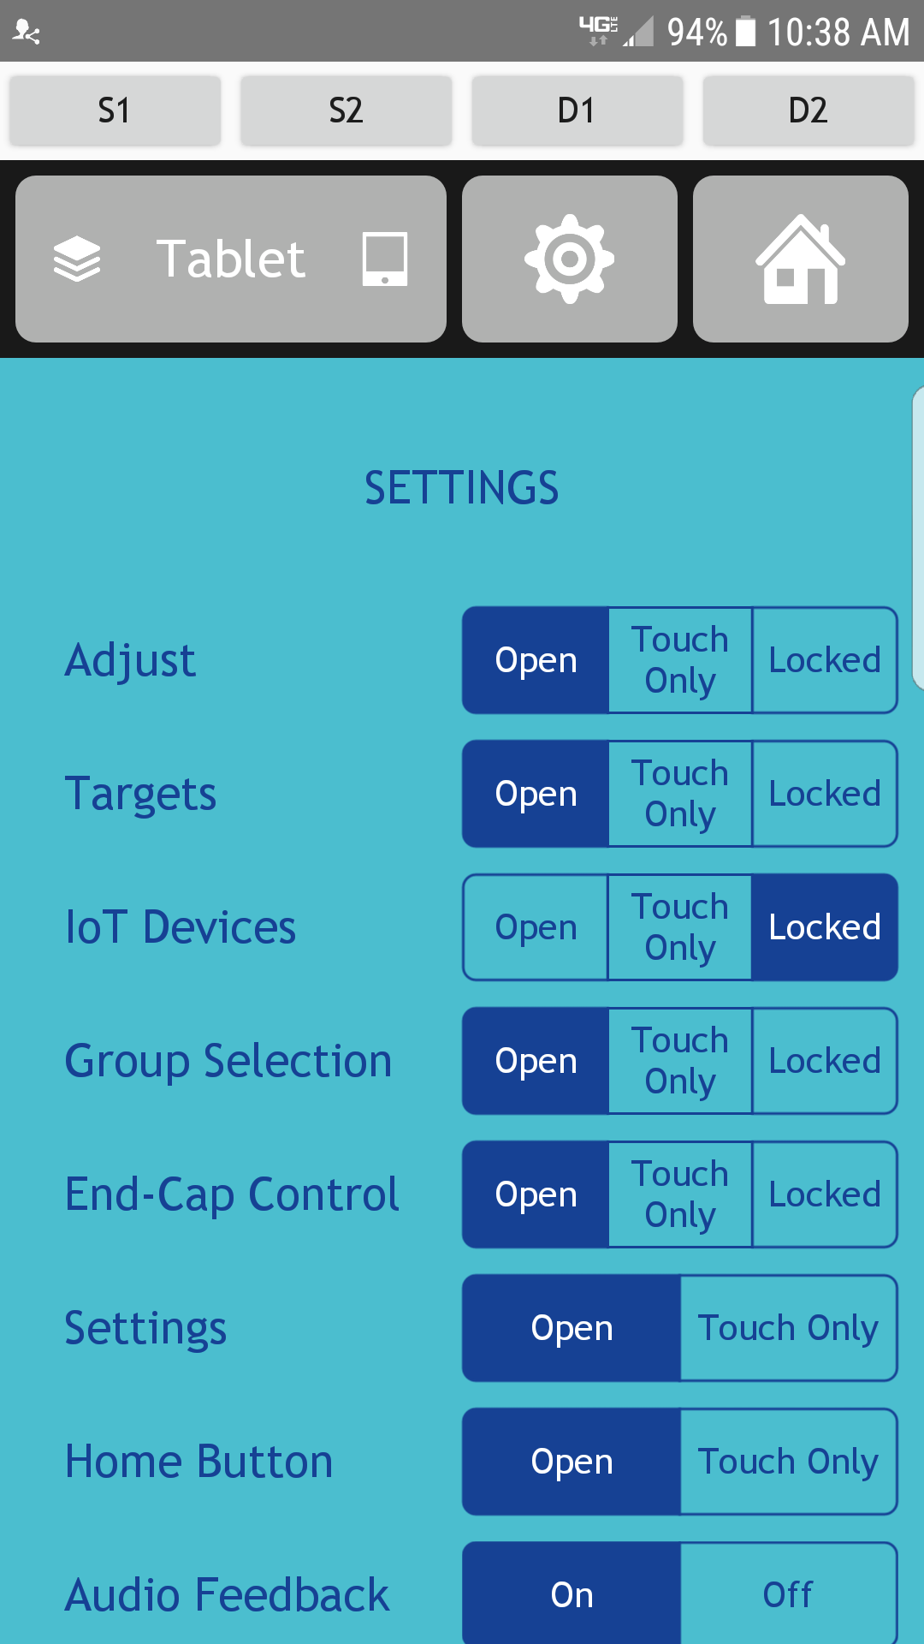
Change App Settings so IOT Devices are available
IOT Devices are Locked
This means the IOT Tab will not appear on the Home Page

Slide 9
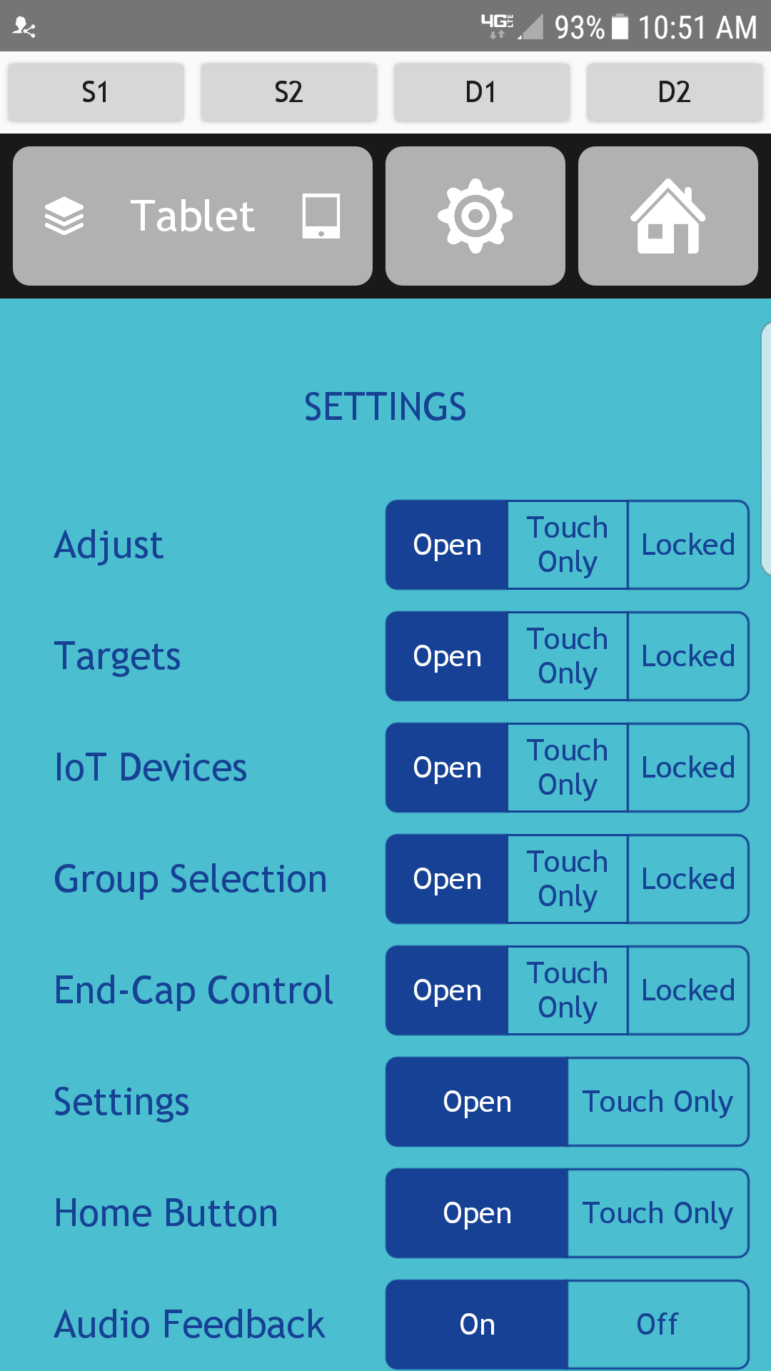
Change the IOT Device Status to Open
This will result in the IOT tab appearing on the Home Page.
All currently available IOT devices will show on the IOT page.

Slide 10
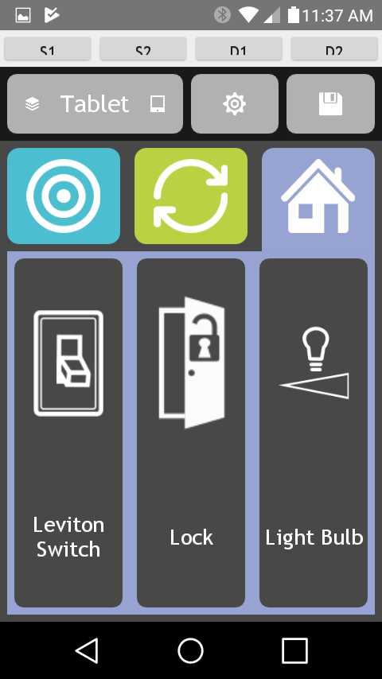
Wink devices display
The icon for each Wink devices indicates the state.
The background color also indicates on or off, with dark brown is Off, and dark blue is On.
Here the switch is off, the lock is unlocked, and the light bulb is off.
In this example, we select the light bulb icon to turn on the light.

Slide 11
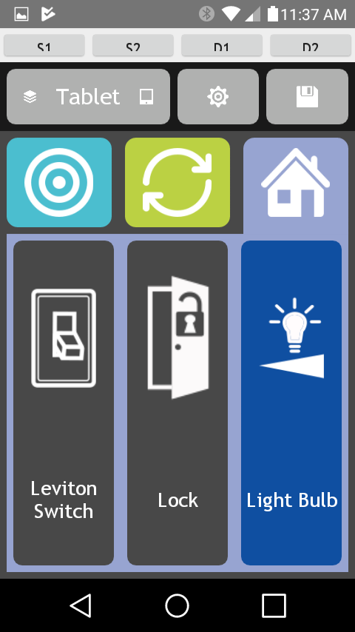
Light is on, let’s Lock the door.
This screen shows the light turned on. Note the blue background.
The door icon indicates it is unlocked (and open).
Select the lock icon to lock it.

Slide 12
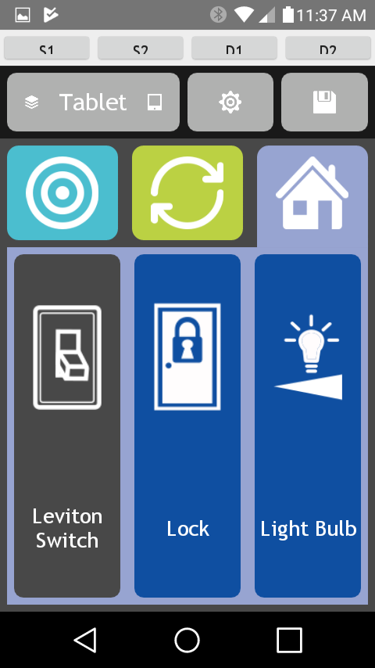
Monitor and change device status
This screen shows the lock locked and the light on.
Select the lock to unlock it;
Select the light to turn it off.
Select the switch to turn it on.

Slide 13
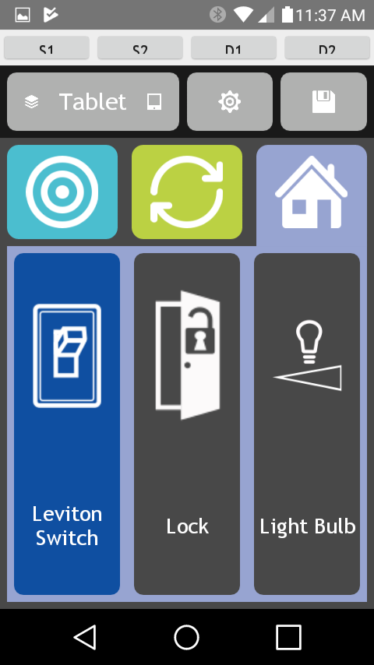
Switch is on
This screen shows the result of selecting each icon once.
The switch is on,
The lock is unlocked, and
The light is off

Slide 14
Adding a device to a Targets page
Follow the step by step instructions to add devices available on your Wink hub to Target pages on the Pow!r Mount app.
This tutorial assumes you have a:
Wink account
Wink hub setup
Devices added to the hub
Pow!r mount

Slide 15
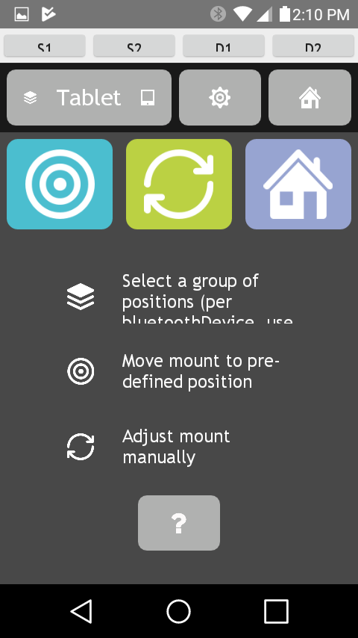
Start at the home screen
Select the settings icon, the gear

Slide 16
Select Mount Settings
Select Mount Settings to edit a group of targets.

Slide 17
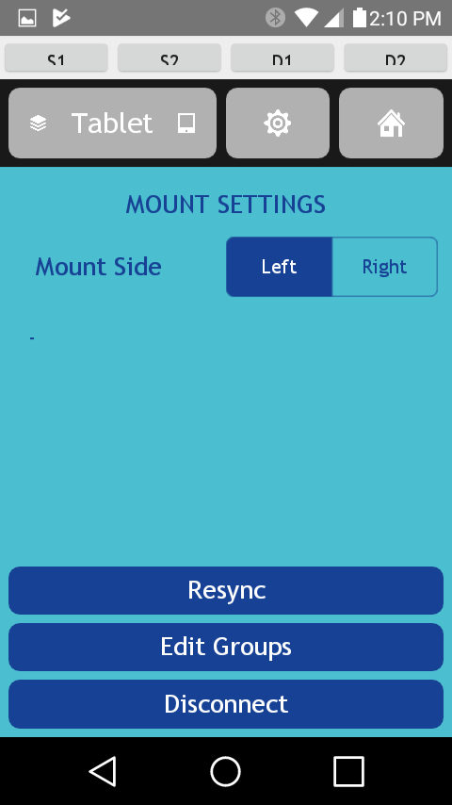
Select Edit Groups
Select Edit Groups

Slide 18
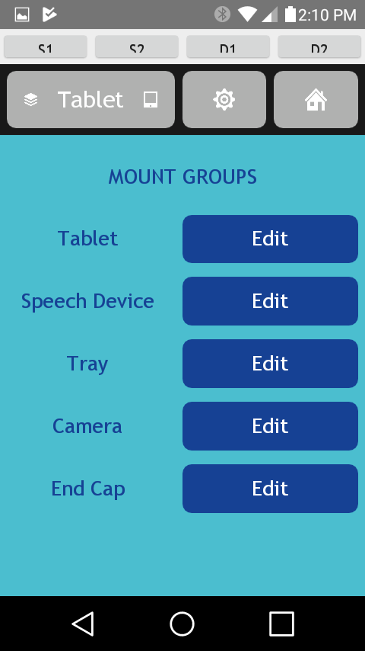
Select a Group: Tablet
Select the group you want to add an IoT device to.
This example uses the Tablet group

Slide 19
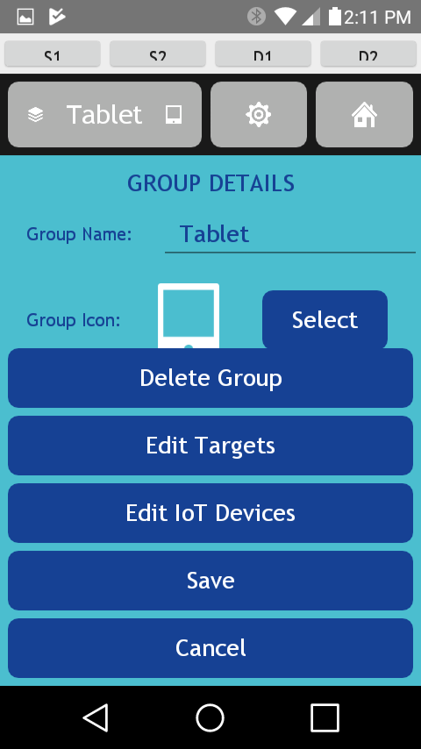
Select Edit IoT Devices
Select Edit IoT Devices

Slide 20
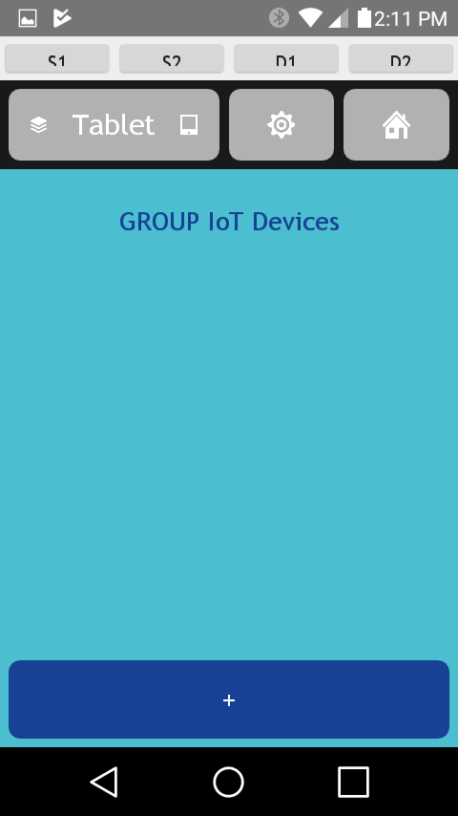
Select the +
Select the + at the bottom of the screen to add a device

Slide 21
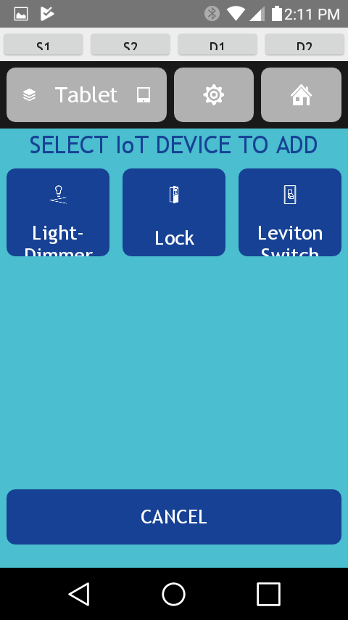
Select an IoT Device
Select the IoT Device you wish to add.
This examples uses the Leviton Switch.

Slide 22
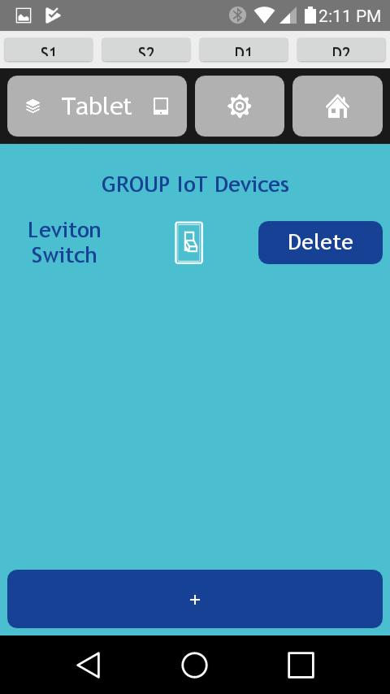
IoT Device added
The IoT device now appears in the group settings list.
This screen also presents you with the option to Delete it.
Select the Home button.

Slide 23
Select the Tablet Target group
Select the Group you added the IoT device to.
Select the Target icon to confirm the IoT device was added.

Slide 24
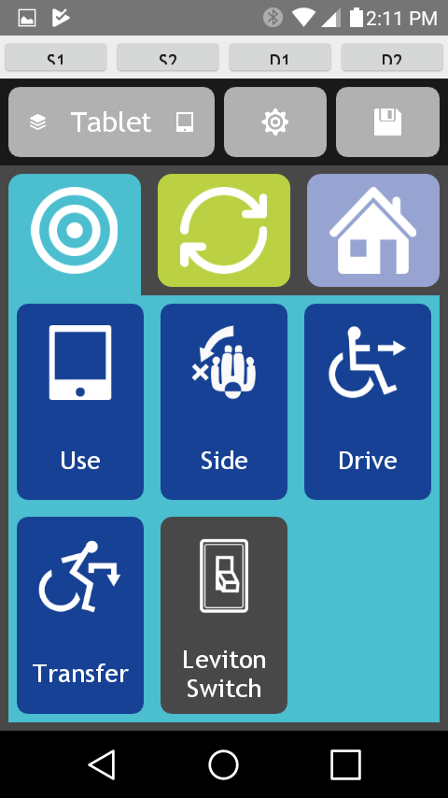
Control the IoT device
The icon to control the IoT device now appears in the target group.
The switch is down and it is dark brown.
This indicates it is off.

